Slide 1


Strategic Cybersecurity Plan
ADMASTER-STAMP!ICR0218U-416799-1330093
Natnael M. Kebede
Managing Director and CISO.
8/4/2020
BlackRock Inc.
Natnael Kebede, Managing Director and CISO

Slide 2
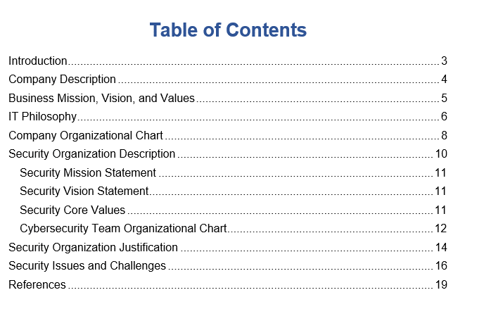
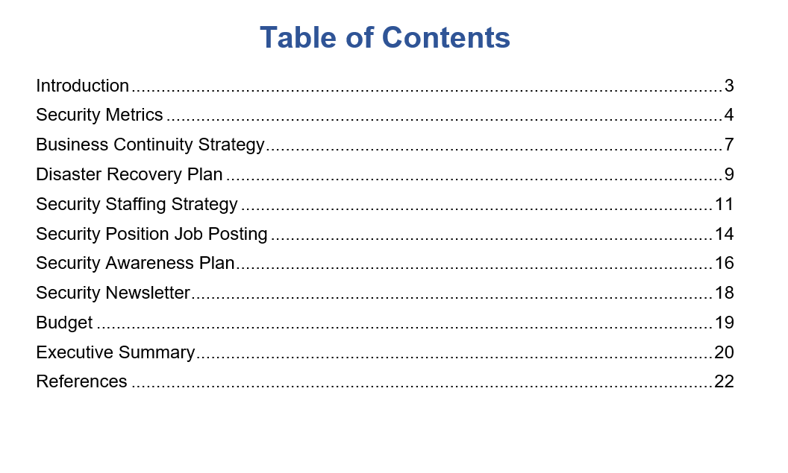
About the Plan
The two-part strategic cybersecurity management plan for BlackRock aims to keep the organization secure and prepared for any incidences that may arise in the realm of information security.
BlackRock INC. Strategic Cybersecurity Plan (I)
BlackRock INC. Strategic Cybersecurity Plan (II)
BlackRock Inc.

Slide 3


The Need for the Plan
For BlackRock, information security relates to the effective use of digital tools to increase productivity, efficiency, competitive advantage, employee engagement, and clients’ insights.
Data breaches, consistent cyber-attacks, and the ever-changing threat landscape.
Severe fines for violation of compliance standards and privacy policies.
Pushing Information Security to the Forefront of An Organization’s Priority List Has Become Crucial.
BlackRock Inc.

Slide 4


Executing the Plan
Executive Team
Board of Directors
Security Department
Employees
Stakeholders

Slide 5
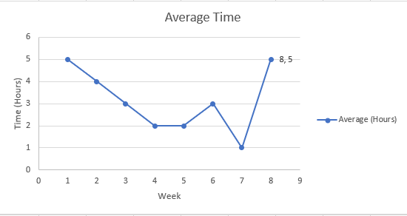
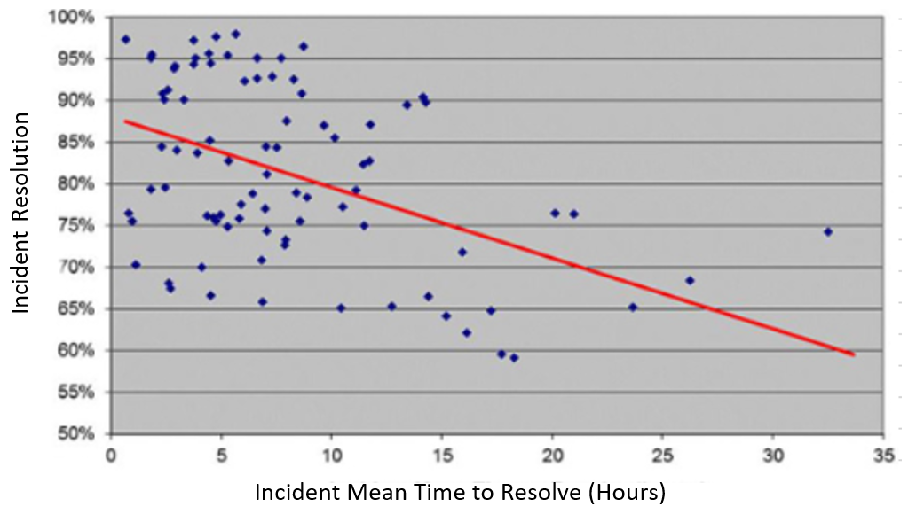
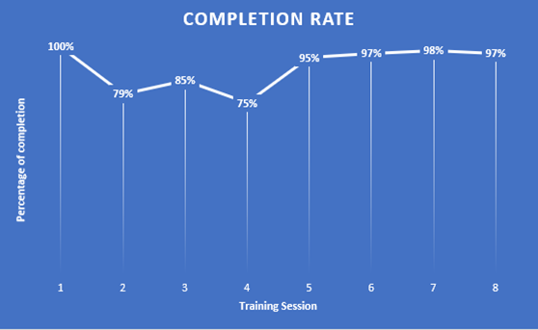
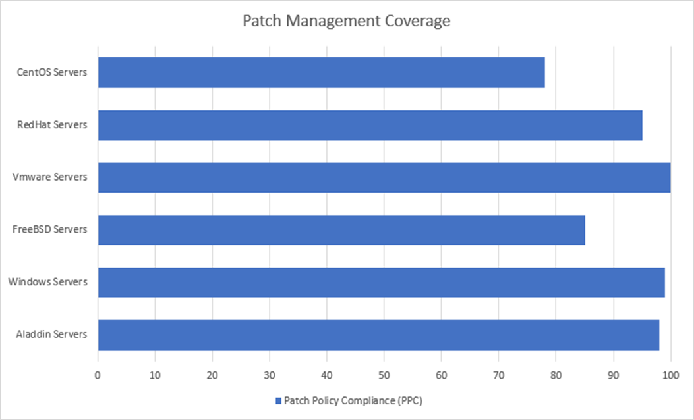
Executing the Plan: Security Metrics and Reporting
Time to Access Resources
Time to Remediate Incidents
Security Awareness Rate
Patch Management Coverage

Slide 6
Executing the Plan: Business Continuity
ADMASTER-STAMP!ICR0218U-416799-1330093
Business Impact Analysis (BIA)
Identification and Classification of Assets
Business Continuity Plan (BCP)
Continuity of Operations
Assessment of Vulnerabilities
Probability of Occurrence and Damage
Risk Identification and Mitigation
Availability of Critical Systems
In the Information Security Space, Anything That Can Go wrong, Will Go Wrong.

Slide 7
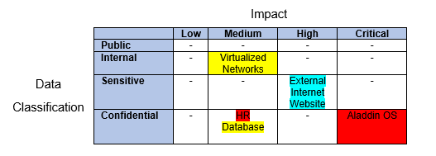
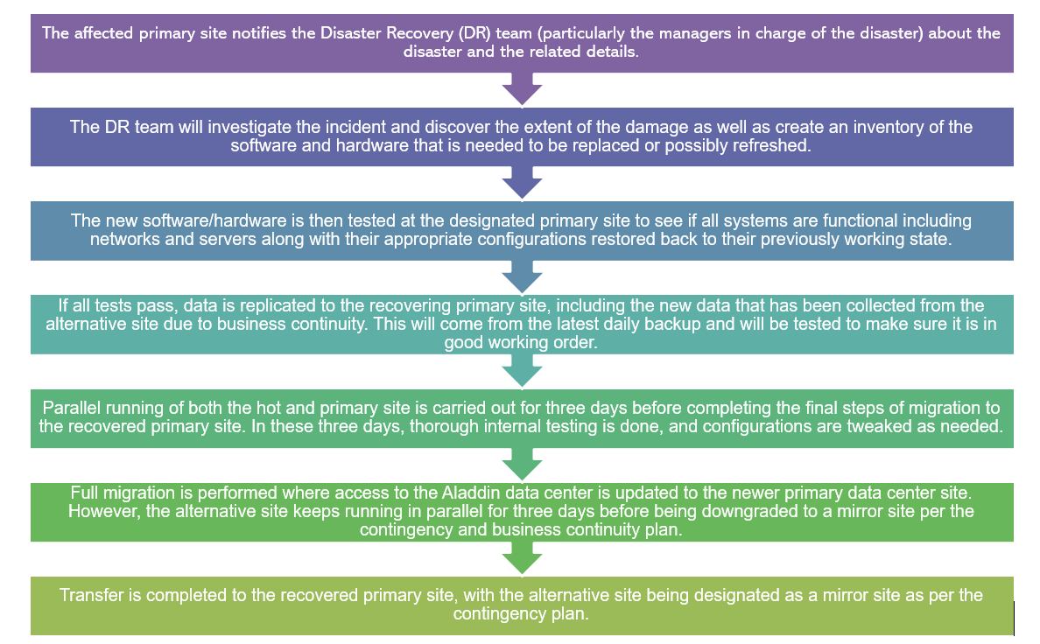
Executing the Plan: Disaster Recovery
Recovering a Highly Valued Asset
BlackRock Inc.

Slide 8
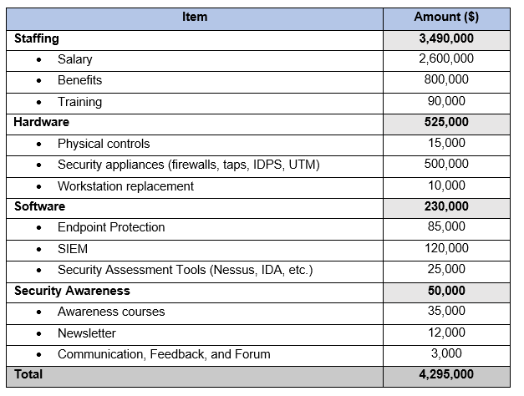
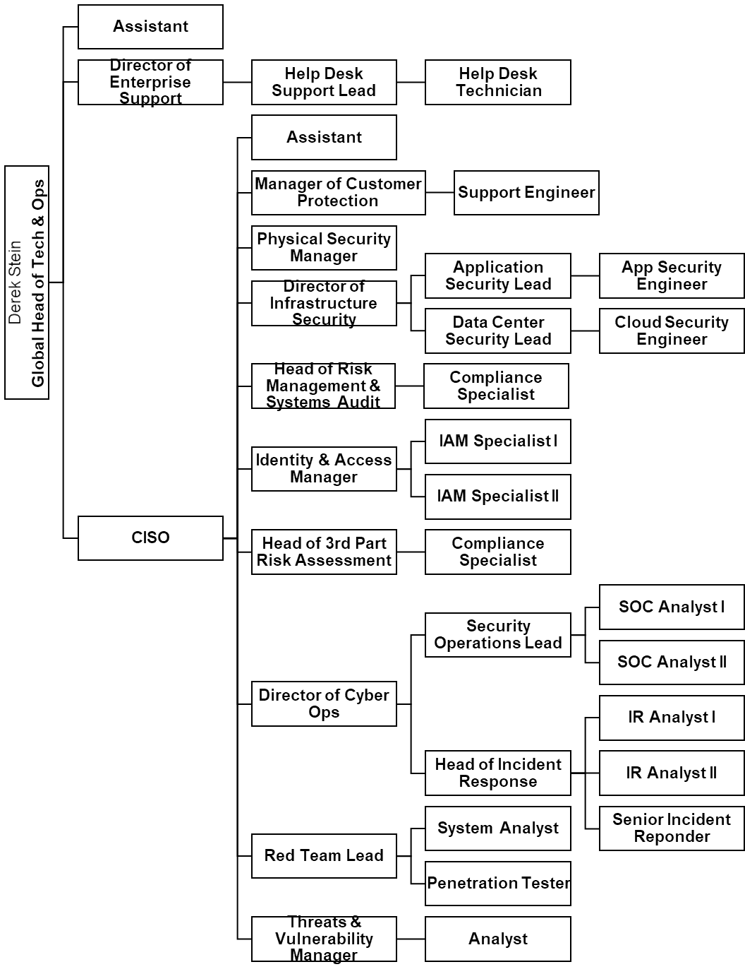
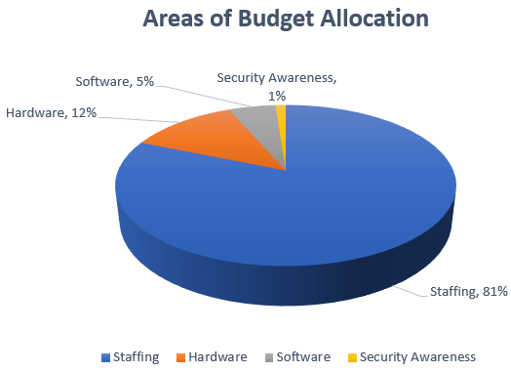
Maintaining the Plan: Essential Elements
Regular revision and update of the plan.
Allocated budget and continual support from associates.
BlackRock Inc.

Slide 9
References
Dempsey, Nieles, Pillitteri. (2017). NIST Special Publication 800-12 Revision 1. An introduction to Information Security. Retrieved from: https://nvlpubs.nist.gov/nistpubs/SpecialPublications/NIST.SP.800-12r1.pdf
E. (2017). Between a Rock and a Hard Place: How BlackRock is Winning the War on Technology – Technology and Operations Management. Harvard Business School. Retrieved from https://rctom.hbs.org/submission/between-a-rock-and-a-hard-place-how-blackrock-is-winning-the- war-on-technology/
Grance, T., Nolan, T., Burke, K., Dudley, R., White, G., & Good, T. (2006). Guide to test, training, and exercise programs for IT plans and capabilities (No. NIST SP 800-84). https://doi.org/10.6028/NIST.SP.800-84
Grimes, J. (2015). Information Assurance Workforce Improvement Program (DoD 8570.01-M). Retrieved from https://www.esd.whs.mil/Portals/54/Documents/DD/issuances/dodm/857001m.pdf
Hayslip, G. (2018). Security metrics: Telling your Value Story. Retrieved from CSO Online website: https://www.csoonline.com/article/3253332/security-metrics-telling-your-value-story.html
BlackRock Inc.

Slide 10
Questions?
ADMASTER-STAMP!ICR0218U-416799-1330093
Natnael M. Kebede
Managing Director and CISO.
natnael_kebede@blackrock.com
BlackRock Inc.

